Slide 1
UE20CS461A –Project Phase – 2
Project Progress Review #3
Project Title : PAYCRYPTO – A Fintech Application for the Currency of the Future
Project ID : 127
Project Guide : Prof. Gauri Sameer Rapate
Project Team : 1) Aryansh Garg
2) Harsh agrawal
3) Harshit sharma
4) Sagarikha M.

Slide 2
Outline
Abstract and Scope of the Project
Suggestions from Review – 2
Implementation Details
Project Demonstration
Test Plan and Strategy
Results and Discussion
Project Report Draft
Conclusion and Future Work
References

Slide 3
Abstract and Scope
Abstract:
Since we know that the buzz of cryptocurrency is growing exponentially and everyone is eager to try their hands on this new era currency, but the knowledge and awareness about it is quite low among the common people.
It takes a lot of time and efforts to get yourself educated in this domain which not many people are willing to spare and an additional challenge is how to find the reliable source of knowledge in this era of scams.
To overcome all these challenges and to provide people with one stop solution we are building PAYCRYPTO. It is an application from where people can start their crypto journey with minimum efforts.

Slide 4
Abstract and Scope
Abstract:
Now, how it works? As we move our money by investing in stock market and by making transactions to other people and businesses, by using this platform one can do the same with cryptocurrency, after all it is just another currency like rupees and dollars.
Why should you use it? It has price prediction feature that predicts the price of major listed cryptocurrencies so that the user can minimize the risk of investing by knowing about the price fluctuations beforehand and plan their investment strategies accordingly.
In addition to that, the users can do transactions to other users in cryptocurrencies as major companies like tesla and ford have already started accepting cryptocurrency as their mode of payment and in the coming future all the companies are going to do the same.

Slide 5
Abstract and Scope
Scope:
With increasing popularity and use cases of the cryptocurrency a platform that can manage the crypto and is user friendly is need of the hour.
PAYCRYPTO can be used by anyone who wants to make transactions in cryptocurrency to other users or businesses as well as who wants to invest in different cryptocurrencies to gain profits.
The price prediction feature of the application let users minimize their risk of losses while investing in currencies of their choice as cryptocurrency is new in market hence it is very volatile.
People who are not very tech savvy can also use this platform easily as it is very user friendly. The reach of this platform is enormous due to its user friendly nature and increasing popularity of cryptocurrency among people.

Slide 6
Suggestions from Review - 2
Discussed the Infeasibility of twitter data as twitter API is unavailiable and hence were suggested to use News headlines data for the sentiment analysis.

Slide 7
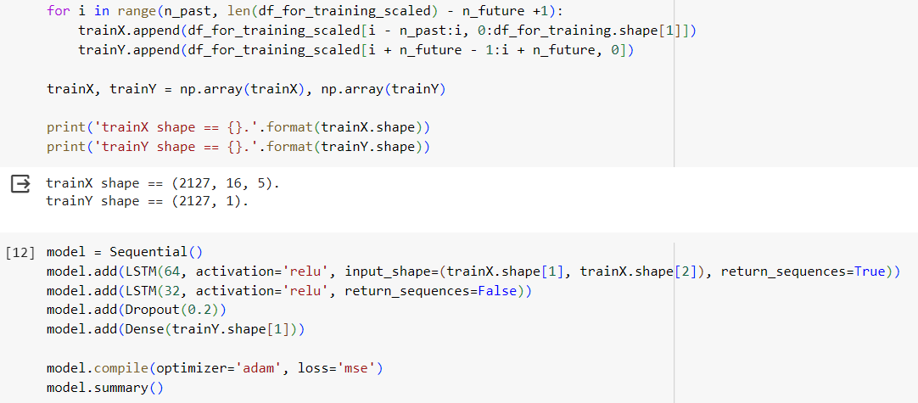
Implementation Details
Price- prediction:
For price prediction, multivariate LSTM model has been implemented. The model uses five features for the forecasting. Since it is a multivariate model, only one day prediction is possible.
Two LSTM layers, one dropout layer and one dense layer has been implemented

Slide 8
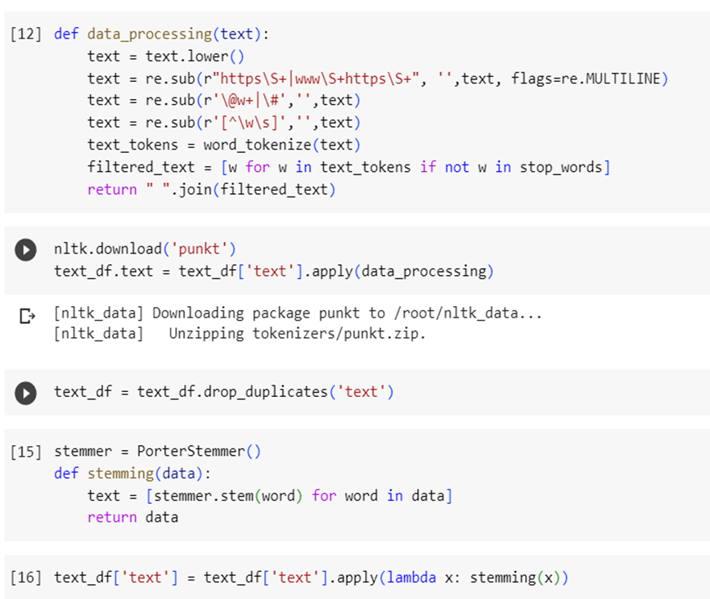
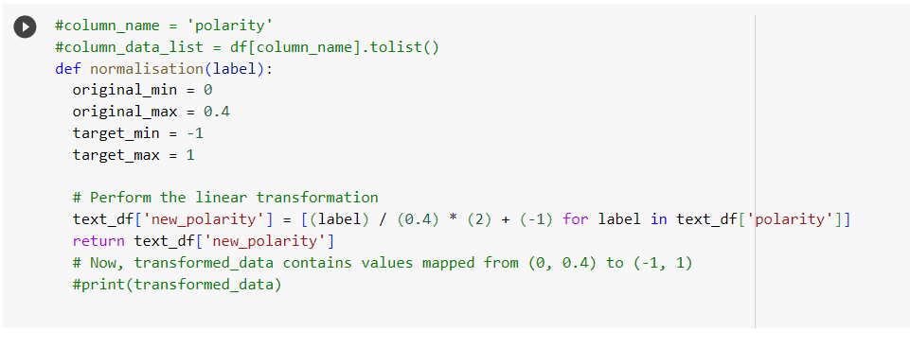
Implementation Details
Sentiment analysis
For sentiment analysis of news data, Textblob is used to get the sentiment of the news headlines.
The sentiment score is then further normalized to give the value between -1 and 1 where the lesser the value, the negative the sentiment.

Slide 9
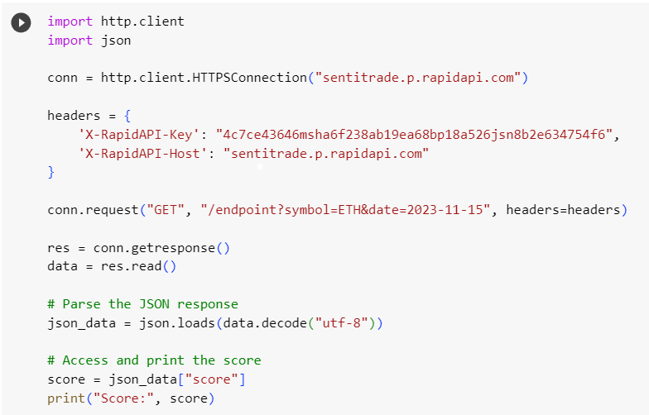
Implementation Details
Sentiment analysis
For getting the news data of everyday, SentiTrade API has been implemented which scrapes the news headlines related to the cryptocurrency market

Slide 10
Project Demonstration
Exhibit the demonstration of the complete project.
It has to be complete in all aspects
Exhibit working of the project

Slide 11
Test Plan and Strategy
For testing the different modules of the project, unit testing method has been followed since all the different modules provide different functionality and each one has to be working independently.
For the frontend part, as it has been build in react JS component testing is followed.
API testing has been performed using postman.
Finally, integration testing has been done to test the feasibility and working of all the modules together

Slide 12
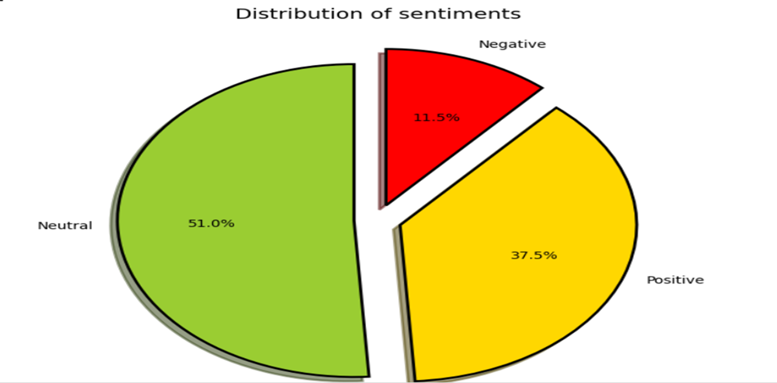
Results and Discussion
For sentiment analysis of news data, after the dataset preprocessing the following results have been obtained for sentiment distribution.

Slide 13
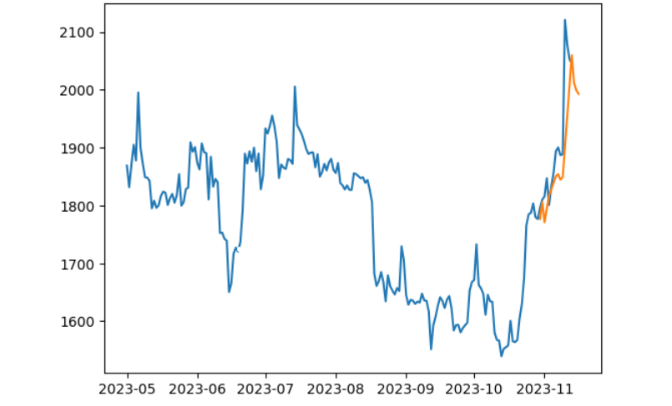
Results and Discussion
For sentiment analysis of news data, after the dataset preprocessing the following results have been obtained for sentiment distribution.

Slide 14
Conclusion and Future work
TextBlob for news sentiment analysis provides satisfactory results by giving the sentiment score between -1 and 1 where lesser score means negative sentiment and higher score means positive sentiments and near zero infers neutral sentiments.
For the price forecasting, LSTM model provides satisfactory results which has been implemented with 2 LSTM layers, one dense layer and one dropout layer.
In the future, licenceing and permissions can be obtained to provide wallet to the users for the transactions and buying currencies.

Slide 15
References
Provide references pertaining to your research according to IEEE format.
Example:
G. Eason, B. Noble, and I. N. Sneddon, “On certain integrals of Lipschitz-Hankel type involving products of Bessel functions,” Phil. Trans. Roy. Soc. London, vol. A247, pp. 529–551, April 1955. (references)

Slide 16
IEEE Draft (Optional)
Display the draft of your project work in an IEEE template if you have prepared to submit it in a Conference/Journal.
Indicate the status of completion as well.
Download the IEEE template from the given link below,
https://www.ieee.org/content/dam/ieee-org/ieee/web/org/conferences/Conference-template-A4.doc

Slide 17
Thank You

